Slide 1


Evaluation of Erasure Coding & other features of Hadoop 3
Nazerke Seidan
Supervisors: Emil Kleszcz, Zbigniew Baranowski
16/08/2019
1

Slide 2

How to reduce storage overhead without affecting the performance of Big Data Processing?
Motivation
2

Slide 3



Hadoop
Compute
Storage
(HDFS)
...
3

Slide 4
Current HDFS Replication Strategy
* 3 replicas by default
* Tolerates up to 2 failures
* Data locality
HDFS
Client
NameNode
file
file metadata
DataNode
DataNode
DataNode
DataNode
200% storage overhead
4

Slide 5
Erasure Coding Feature
5

Slide 6
Erasure Coding (EC)
EC Group Block
1024k
256mb
file
s1
s2
s3
s4
s5
s6
PS1
PS2
PS3
s1
s2
s3
s4
s..
sN
+
s7
s8
s9
s..
s..
sN
PS4
PS5
PS6
Data is striped
Distributed to N data chunks
Compute K parity chunks using Reed-Solomon(N,K)
* Similar to RAID 5/6 concept
* Uses a codec algorithm eg. Reed-Solomon (RS)
* RS (N,K) where N - data chunks, K - parity chunks
* Generates K parity chunks based on N data chunks
* Tolerates up to K failures
* Stripe cell 1024k, block size 256mb
6

Slide 7
Why parity chunks are needed?
7

Slide 8
Block Recovery with EC
s1
s2
s3
s4
s5
s6
PS1
PS2
PS8
+
s2
s5
file
s1
s2
s..
sN
s7
s8
s9
s..
s..
sN
PS4
PS5
PS..
s8
s..
Reassemble N stripe
Reconstruct failed chunks
* Failed 2 data blocks
* Client-side recovery scenario
* Server-side recovery is triggered after heartbeat interval
8

Slide 9
EC Policies & 3x Replication
Replication Policy | Additional Storage Cost | Fault Tolerance
RS(3,2) | 66% | 2
RS(6,3) | 50% | 3
RS(10,4) | 40% | 4
3x replication | 200% | 2
RS(N,K): Reed-Solomon codec
N – number of data chunks
K – number of parity chunks
9

Slide 10
Evaluation Methods
* Raw storage performance (write/read):
- small datasets eg., 128KB, 1MB, 100MB, etc
* Analytics performance:
- TPC-DS benchmark test on Spark on 100GB, 1TB, 10TB
- different file formats i.e. JSON, Parquet
Our production-like cluster:
16 machines,
48 drives/machine
5.5TB/drive
TPC-DS benchmark configuration:
84 executors,
48GB executor memory,
4 executor cores
10

Slide 11
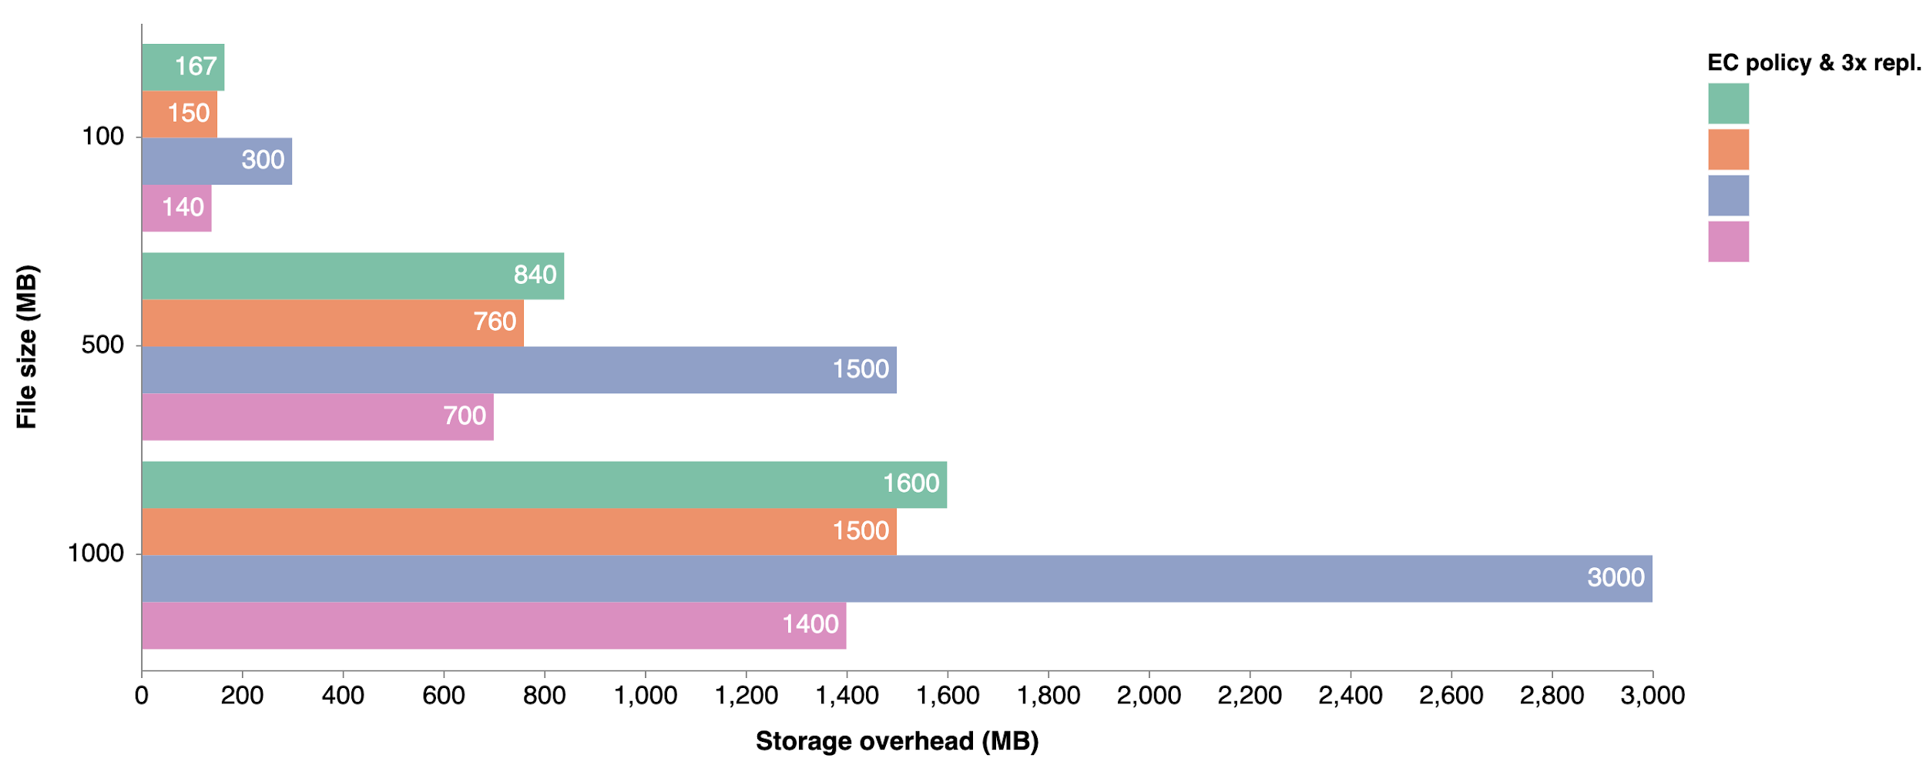
Evaluation Results
RS(3,2)
Storage Overhead < 50% with EC
Storage Cost < 60% with EC
RS(6,3)
3x replication
RS(10,4)
(Lower is better)
11

Slide 12
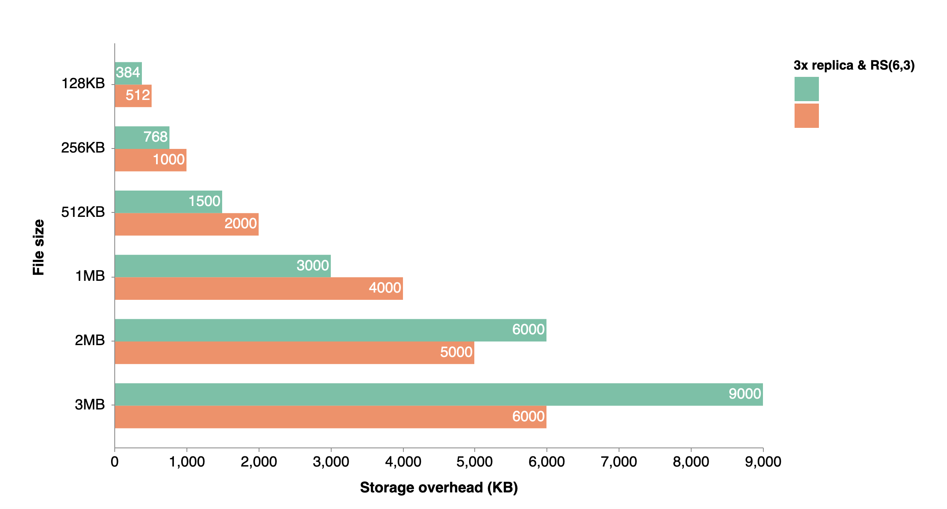
But with small datasets …
3x repl.
RS(6,3)
EC is not recommended for small datasets especially for the files smaller than the stripe
(Lower is better)
** Hadoop is not for small datasets
12

Slide 13
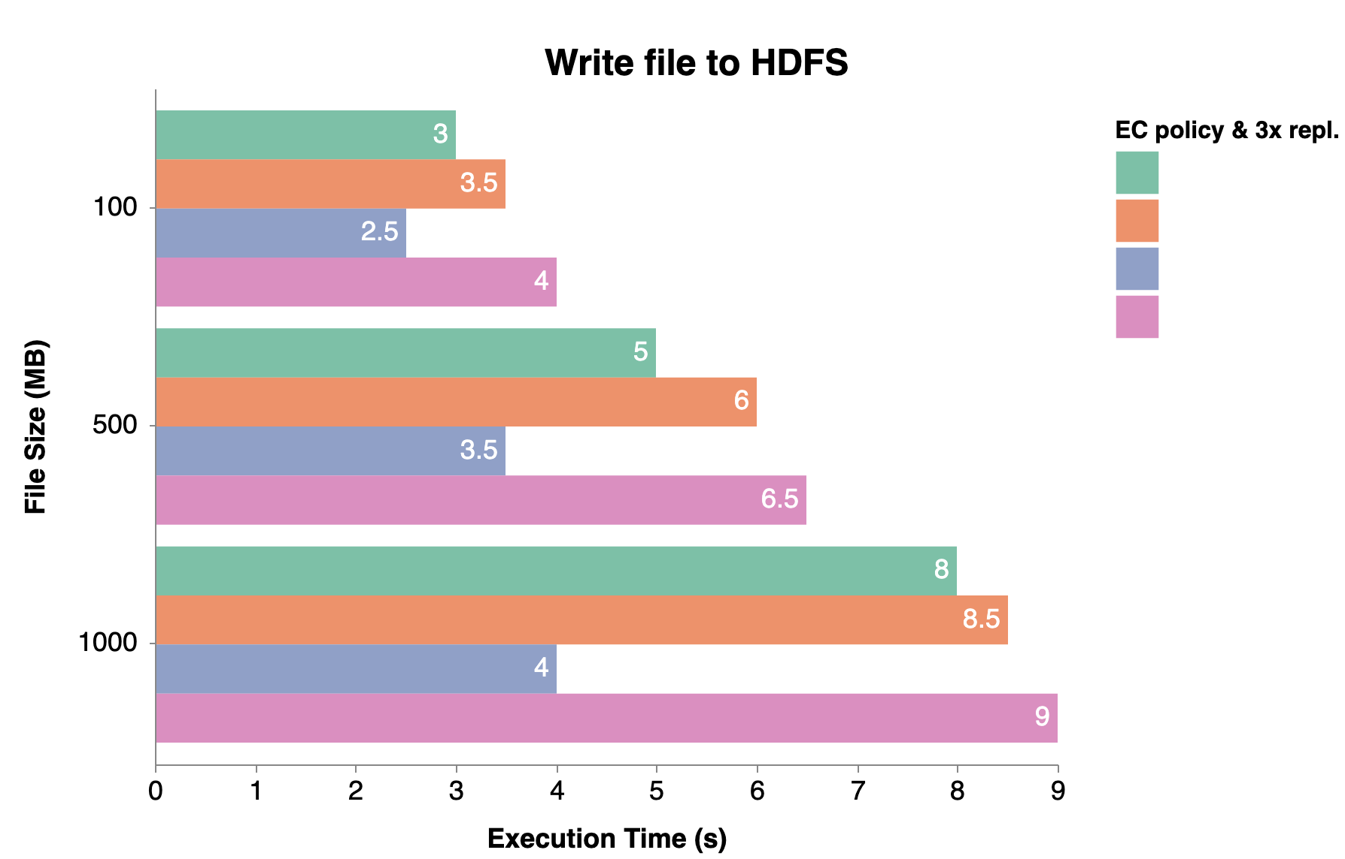
Evaluation Results
(Lower is better)
RS(3,2)
RS(6,3)
3x repl.
RS(10,4)
40-50% slower with EC
13

Slide 14
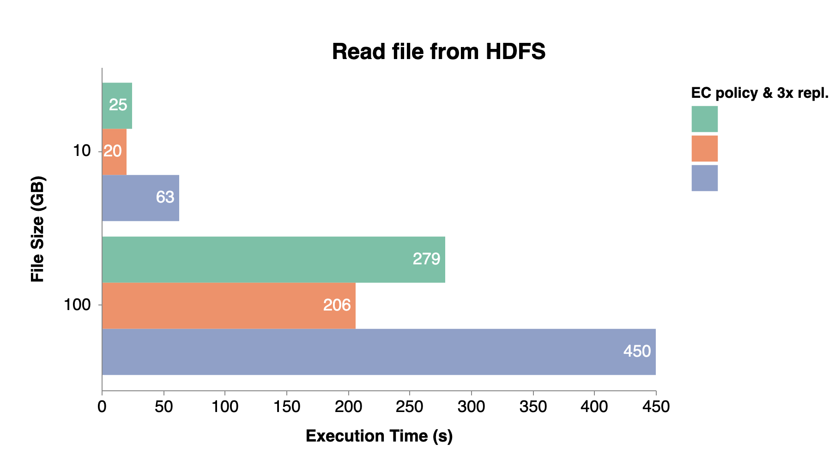
Evaluation Results
Intel® ISA-L
(Lower is better)
RS(3,2)
RS(6,3)
3x repl.
2x faster with EC
14

Slide 15
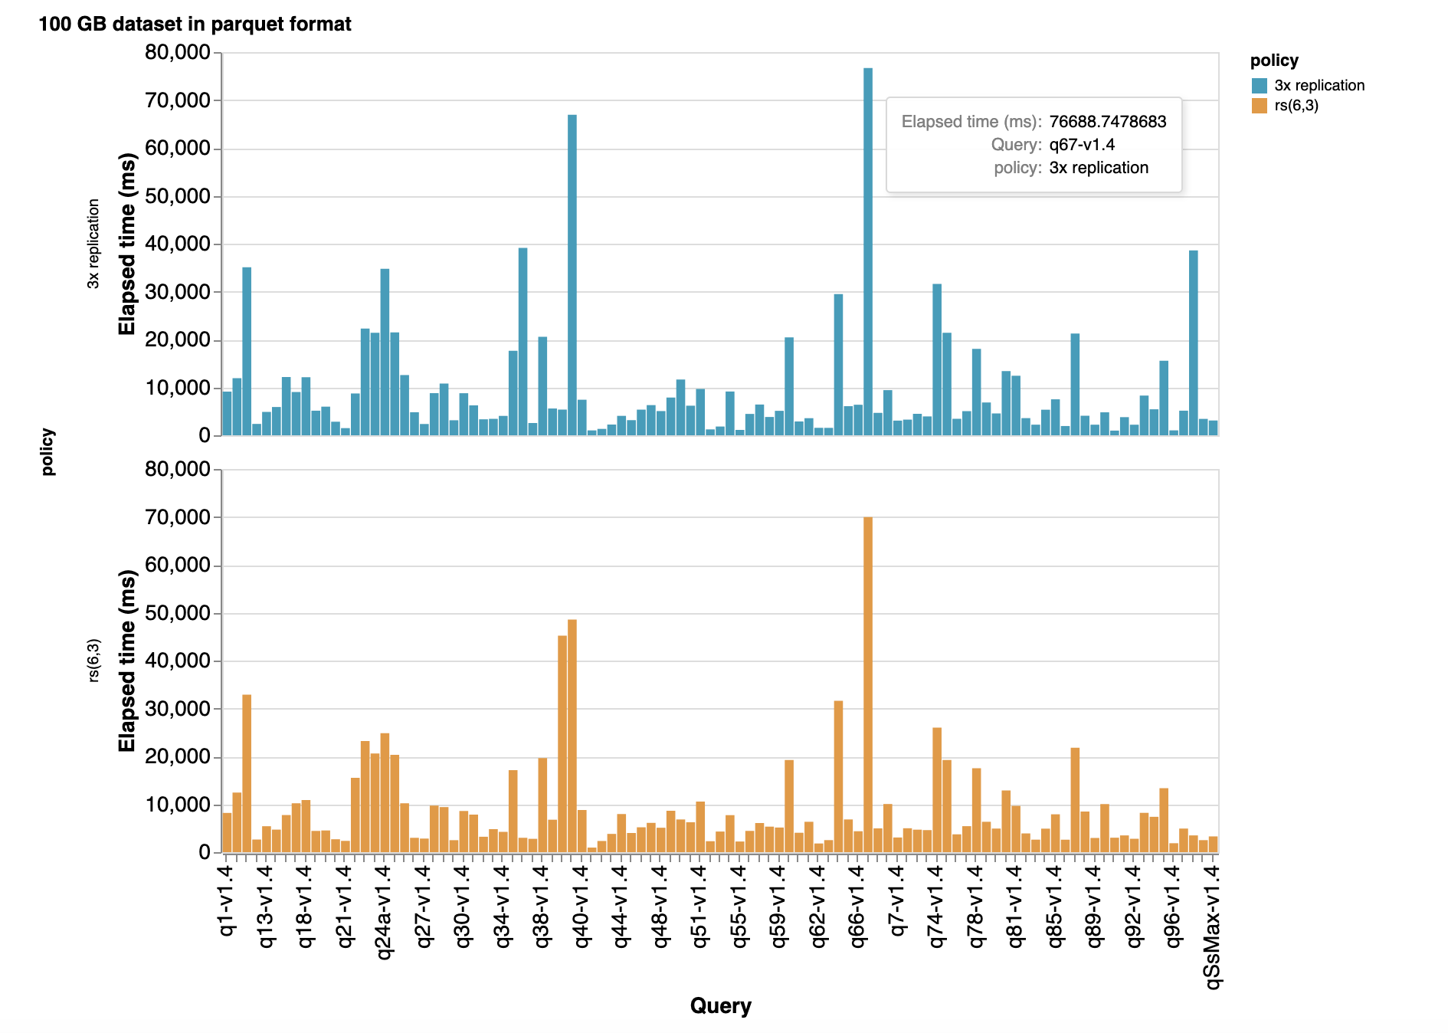
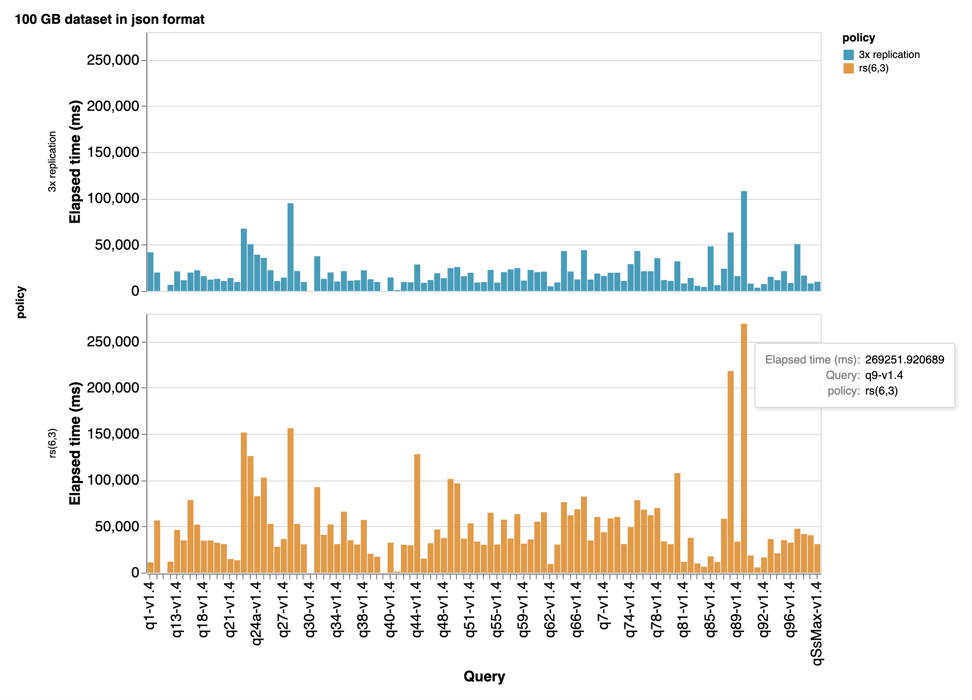
TPC-DS benchmark test
* TPC-DS: decision support benchmark
Avg. exec. time: ~40 min.
Avg. exec. time: ~80 min.
Avg. exec. time: ~16 min.
15

Slide 16
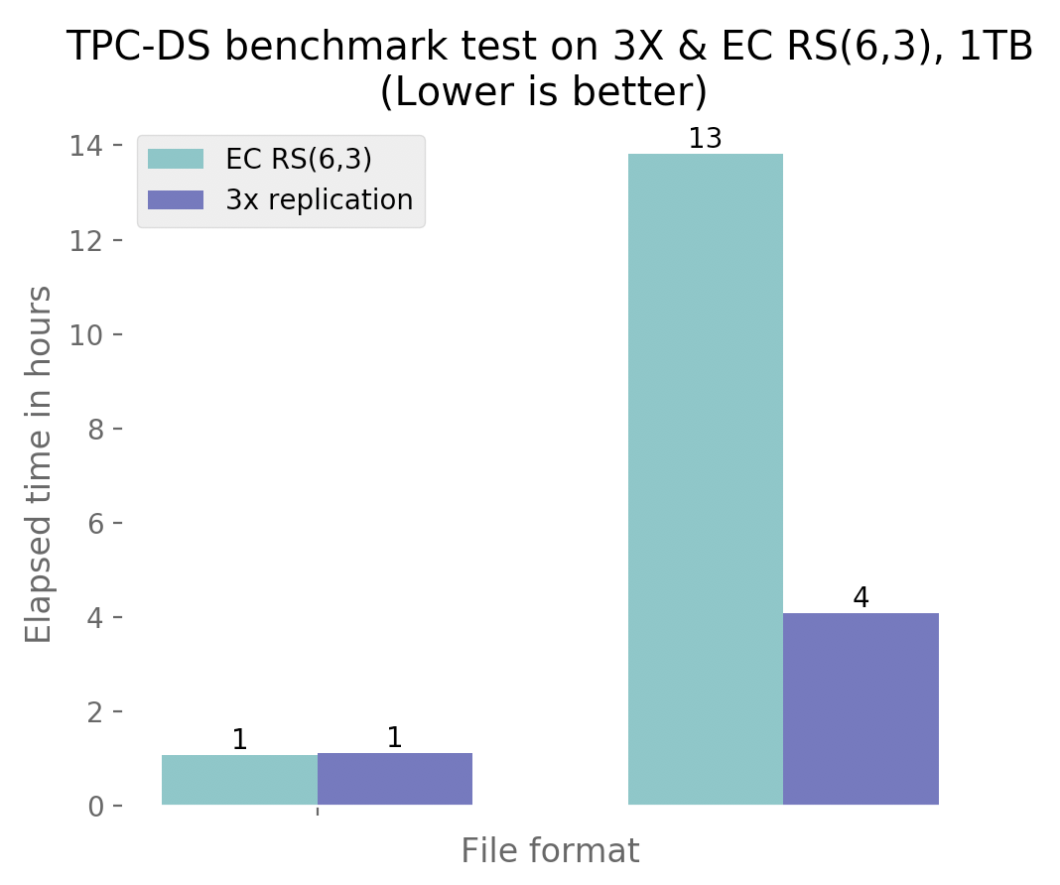
Evaluation Results
Unoptimized file formats should be avoided with EC
Performance with optimized file formats is the same for both replication policies
Parquet
Json
16

Slide 17
Triple NameNode Feature
17

Slide 18
Current NameNode Architecture
ZK
ZK
ZK
Heartbeat
Failover
Controller Active
Heartbeat
JN
JN
JN
Failover
Controller Standby
Monitor Health of NN. OS, HW
Shared NN State through Quorum JNs
NN Active
NN Standby
Monitor Health of NN. OS, HW
Block Reports to Active & Standby
DN
DN
DN
DN
18

Slide 19
What if both NNs fail?
ZK
ZK
ZK
Heartbeat
Failover
Controller Active
Heartbeat
JN
JN
JN
Failover
Controller Standby
Monitor Health of NN. OS, HW
Shared NN State through Quorum JNs
NN Active
NN Standby
Monitor Health of NN. OS, HW
Block Reports to Active & Standby
DN
DN
DN
DN
19

Slide 20
Triple NameNode High Availability
ZK
ZK
ZK
Heartbeat
Heartbeat
Failover
Controller Standby
Failover
Controller Active
Heartbeat
JN
JN
JN
Failover
Controller Standby
Monitor Health of NN. OS, HW
Shared NN State through Quorum JNs
NN Active
NN Standby
NN Standby
Monitor Health of
NN. OS, HW
Block Reports to Active & Standby
DN
DN
DN
DN
20

Slide 21
What Next?
Evaluate the other feature of Hadoop 3:
* HDFS Router-based Federation
21

Slide 22
What Next?
hdfs://federation/test/myfile
State Store
federation
/test
namespace2
namespace1,
namespace2
/root
namespace1
namespace2
R
R
R
R
R
NN
Active
NN
Standby
NN
Standby
NN
Active
NN
Standby
DN
DN
DN
DN
DN
DN
DN
22

Slide 23



Contact:
Nazerke Seidan
Thank you for your attention!
github.com/nazerkebs
linkedin.com/in/nazerkes
Any Questions?
seinaz1997@gmail.com
23

